Slide 1
Exploratory Data Analysis(EDA) For Credit Risk Analysis

Slide 2
Team Introduction:
S.Gurupreet Kaur(Team lead)
Sadiya Iman(Co-Team lead)
A.Veekshana
Aiman Hussain
Revanth Darshan R
Sudem S Daimari
Sara Naazneen
Barun Khanna
CH.Harshitha
Data Cleaning
Univariate Data
Bivariate Data

Slide 3
What is the intent behind conducting this analysis?
Credit risk analysis serves several purposes, including:
1. Assisting the company in determining whether to approve a loan application.
2. Managing and mitigating potential business losses for the company.
3. Minimizing financial risks and losses for the company.
4. Evaluating an applicant's profile to inform decision-making.

Slide 4
Process that took place in completing the Analysis
Working on Data:
Understanding the data and analysing the data
2. Cleaning the data:
Filling in null values, checking for Outliers and eliminating errors
3. Merging the data:
4. Performing the Analysing on data:
Univariate and Bivariate analysis
5. Drawing the conclusions from the data:

Slide 5
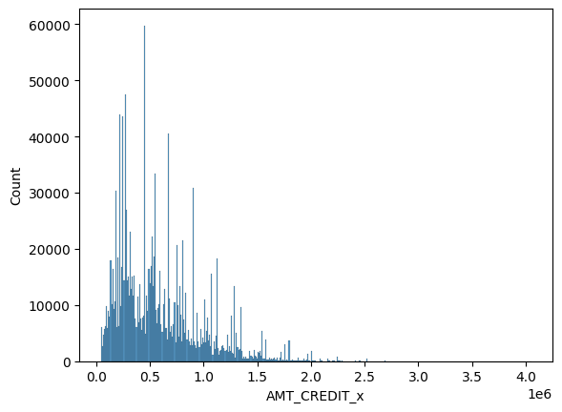
Some Charts drawn from univariate analysis:
We are checking for the highest credit value currently present in the data.

Slide 6
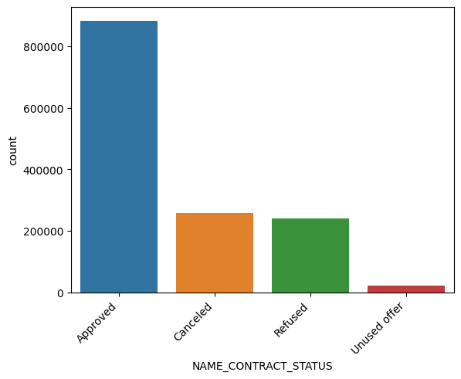
The status of the amount of loans approved, Cancelled, Refused.

Slide 7
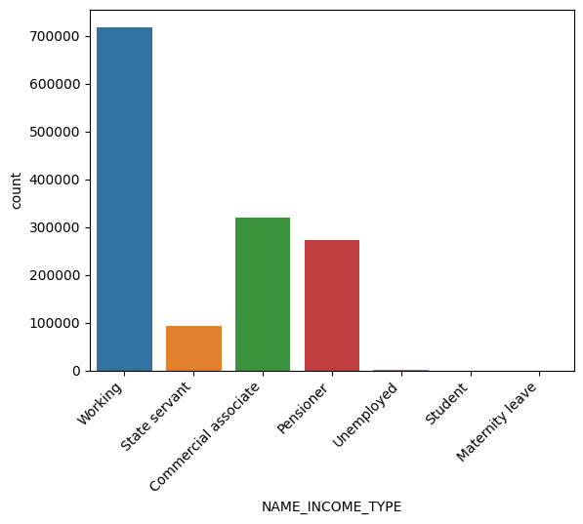
The status of the job of the client.

Slide 8
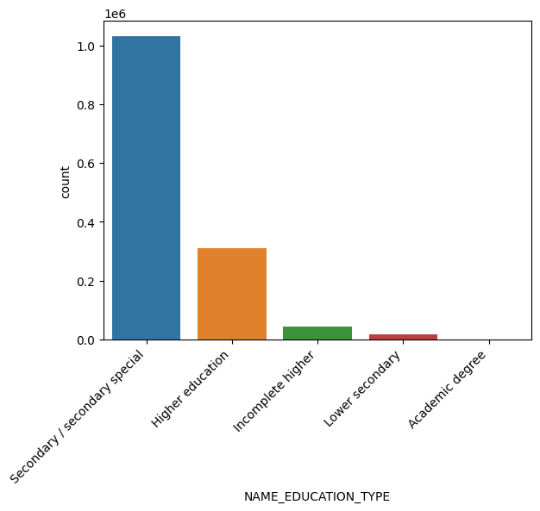
Education status of the client.

Slide 9
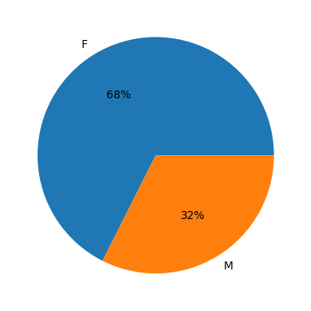
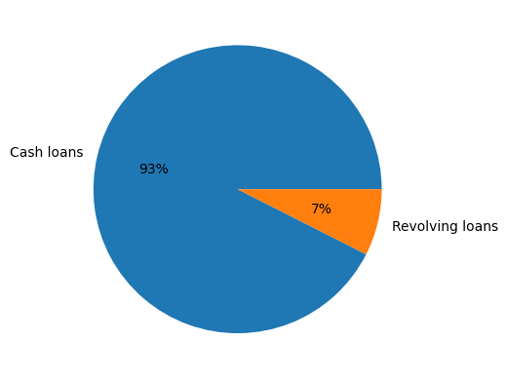
The female and male ratio who have applied to the loan and the type of loan that was applied for the most.

Slide 10
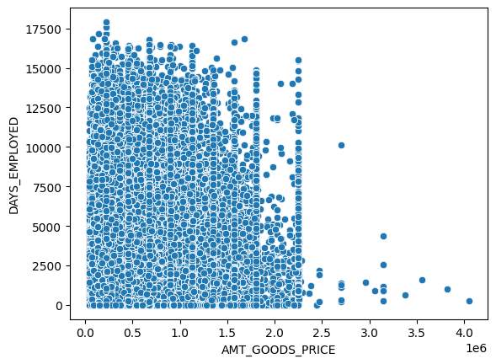
Some Charts drawn from Bivariate analysis:

Slide 11
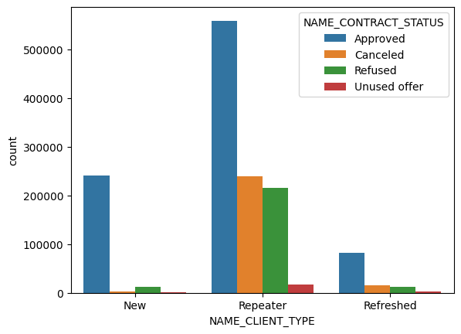

Slide 12
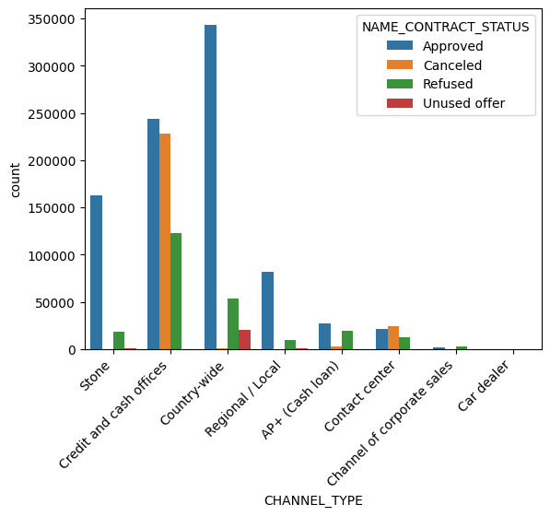

Slide 13
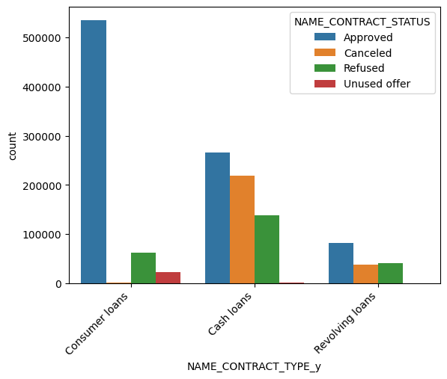

Slide 14
Conclusion:
Loan eligibility criteria:
1. Age requirement: Clients should be between 30 and 50 years old.
2. Family size: Clients should have two to three children.
3. Academic qualifications: The clients' academic record should indicate a decrease in criminal activity.
4. Gender preference: Female clients are considered more suitable for loans than male clients.
5. Family size consideration: Clients with a high number of family members should be rejected.
6. Employment status: Clients working on daily wages may not be eligible.
7. Age restrictions: Clients aged 22 to 25 or 60 and above should not be considered for loans.

Slide 15
Final point
We prioritize the company's interests over the client's, ensuring the repayment of the loans we provide. This is the rationale behind our thorough analysis, which aims to confirm that we are extending loans to the most suitable individuals.
Google Colab Link:
https://colab.research.google.com/drive/1sPS68c3RHEVYdvQO9RJcExKeBI8VCYuv?usp=sharing

Slide 16


